Slide 1
2019
SATs
INFORMATION EVENING

Slide 2
Overview
Process
Assessment and reporting to parents / carers
Numeracy in more detail
Literacy in more detail
How can you help and support your child?
What are we doing to help and support your child?

Slide 3
New National Curriculum introduced in September 2014.
Test outcomes are no longer measured and reported in levels.
A new system of SCALED SCORES is now used.

Slide 4
SATs provide a “snapshot” indicator of how well a pupil is doing compared to their peers, both locally and nationally.

Slide 5
SATs tests are the last national test prior to taking their G.C.S.E. exams.
SATs results provide an important reference point for the next four years of their education and as a result, it is important that we all work together to help and support them to do the best that they can.

Slide 6
QUICK FIXES
PUNCTUALITY & ATTENDANCE
A GOOD NIGHT’S SLEEP
CORRECT EQUIPMENT
Black handwriting pen
2b pencil
Ruler
Rubber
Sharpener
Some tissues
A small bottle of water
A GOOD BREAKFAST

Slide 7
Week beginning 13th May
Mon GPS (45 mins + 15 mins)
Tue Reading paper (60 mins)
Wed Arithmetic (30 mins)
Reasoning (40 mins)
Thu Reasoning (40 mins)

Slide 8
The test score will be converted in to a ‘scaled’ score, using a conversion table.
A scaled score of 100 represents the national standard (or ARE - Age-Related Expectation)
A pupil who has reached the national standard will be deemed to be well-placed to succeed in the next phase of their education.

Slide 9
NUMERACY

Slide 10
In Numeracy, the National Curriculum and SATs address the following skills:
Fluency
Reasoning
Problem-solving

Slide 11
SATs Paper 1:
Arithmetic Fluency skills
36 questions in 30 minutes, gradually increasing in difficulty
Calculation methods for all four operations
Calculation methods using fractions, percentages and decimals

Slide 12
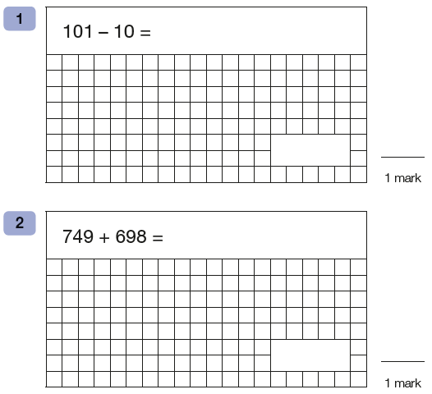

Slide 15
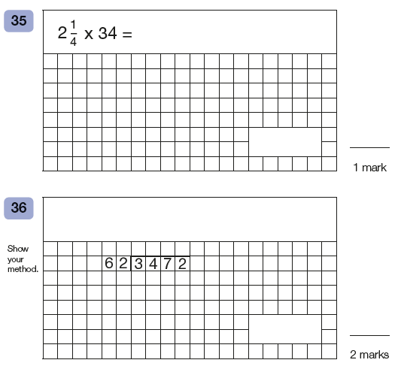

Slide 16
SATs Papers 2 and 3:
Reasoning and Problem-solving
About 20 questions each in 40 minutes
To some extent questions gradually get more difficult, though not as clear-cut
Require calculation skills, answering questions in context and deciding what is required to find a solution

Slide 17
Fluency
Recalling maths knowledge quickly and accurately
Applying knowledge of calculations and methods across contexts

Slide 18
How do we practice Fluency in school?
Continually presenting students with arithmetic calculations and simple numeracy questions in a variety of contexts

Slide 19
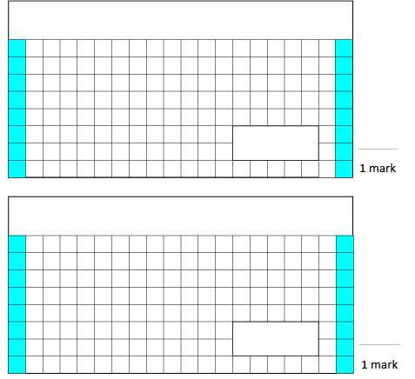
Week 1
1.
0.8 X 7 =
3. Put these numbers in ascending order.
123,546 123,456 1,123,645 132,456
_____ _____ _____ _____
2.
__ = 55,000 – 8,000
Solutions
5.6
47,000
123,456 123,546 132,456 1,123,645

Slide 20
Week 2

Slide 21
How can you practice Fluency at home?
Fluent in Five
(resources on our website)
Arithmetic Tests – 10 questions
Corbett Maths Primary: 5 a day
(free website, links on our website)

Slide 22
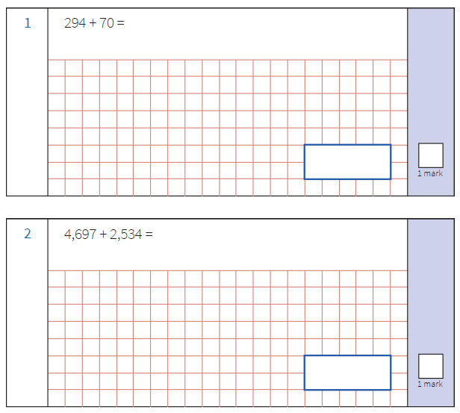
Fluent in Five

Slide 23
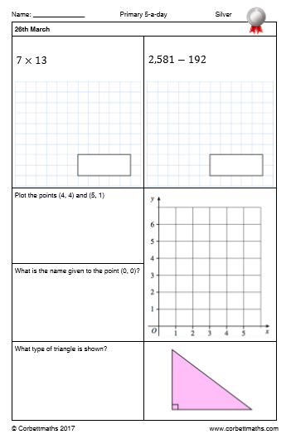
Corbett Maths Primary: 5 a day

Slide 24
Reasoning
Using calculations and mathematical language to prove an ‘argument’
Being able to generalise using a strategy or method

Slide 25
How can we improve Reasoning?
Get children thinking:
What’s the best way of solving this problem?
What do I know that can help me solve this problem?

Slide 26
How do we practice Reasoning in school?
Deep questioning of students in lessons
Examples in ‘Answer Free Zones’
Working with other classmates to discuss and develop mathematical ‘arguments’
Practicing questions that require this skill

Slide 27
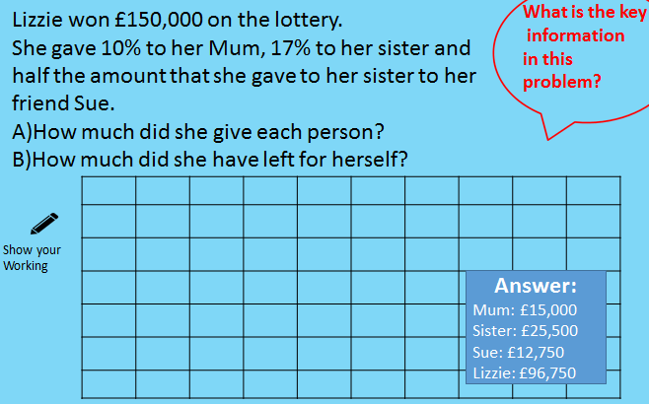
Answer-Free Zones

Slide 28
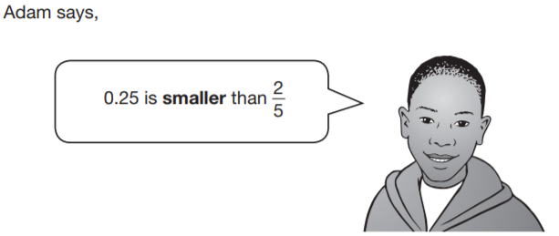
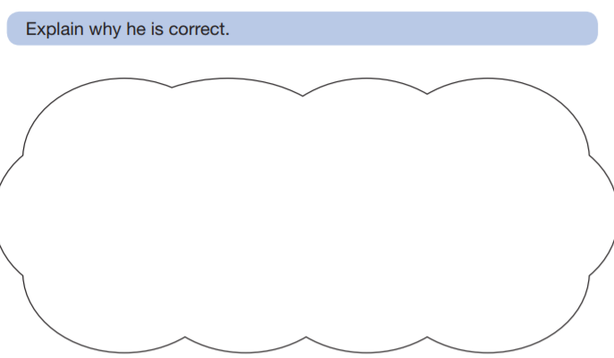

Slide 30
How can you practice Reasoning at home?
Reasoning prompts
(resources on our website)
White Rose Reasoning questions
(resources on our website)

Slide 31
Reasoning Prompts

Slide 32
Problem-solving
Applying maths knowledge to situations that are familiar as well as new contexts
Breaking down problems into smaller steps, and knowing what order to do the calculations

Slide 33
How can we improve Problem-solving?
Get children thinking/practicing 5 types:
Word problems
Visual problems
Finding all possibilities
Logic problems
Rules and patterns

Slide 34
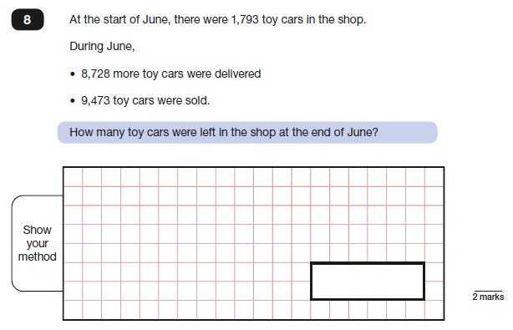
Word problems

Slide 35
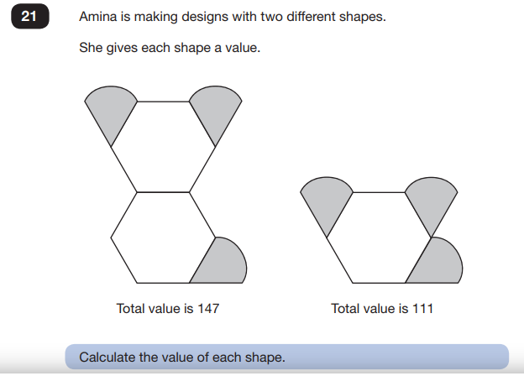
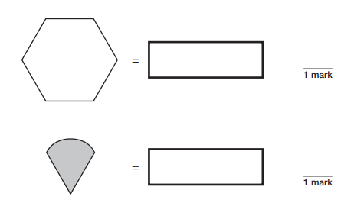
Visual problems

Slide 36
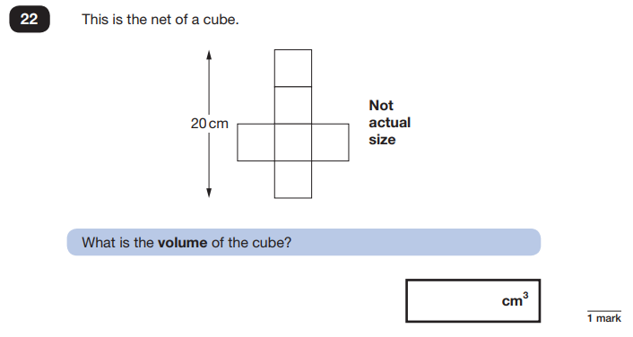
Visual problems

Slide 37
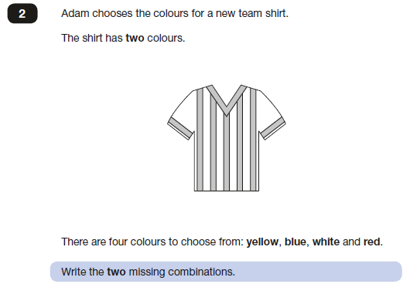
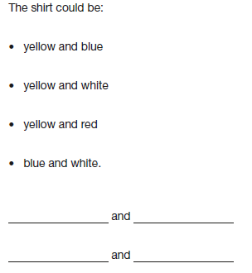
Finding all possibilities

Slide 38
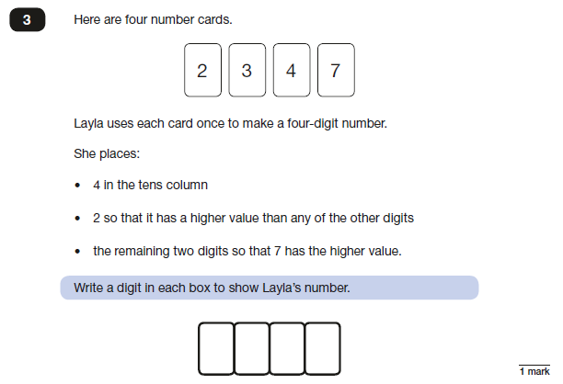
Logic problems

Slide 39
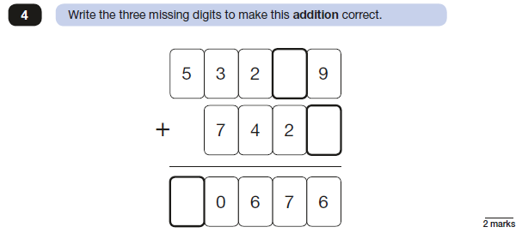
Logic problems

Slide 40
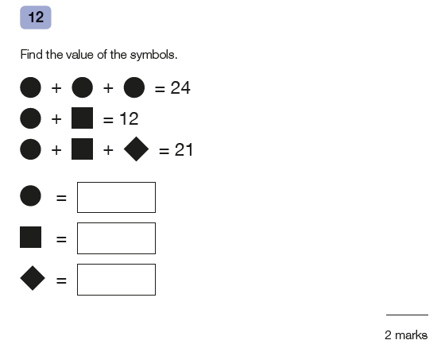
Rules and patterns

Slide 41
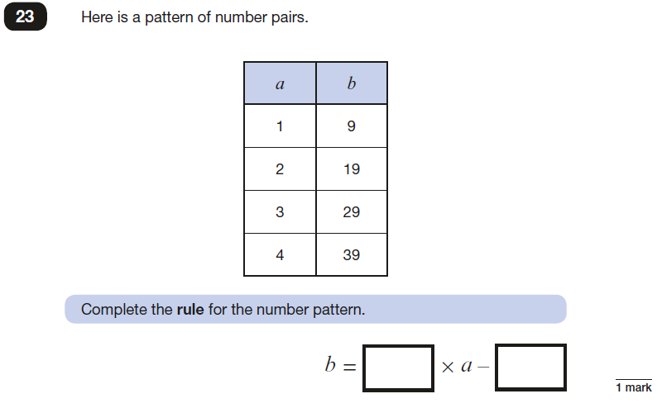
Rules and patterns

Slide 42
How can you practice Problem-solving at home?
White Rose Reasoning and Problem-solving questions – 2016 and 2017
Maths Made Easy practice papers

Slide 43
And…Times Tables !
Last year 19/36 questions in Paper 1 require children to have fluent times tables knowledge
Last year 18/44 questions in Papers 2 and 3 require children to have fluent times tables knowledge, with additional questions requiring use of times tables
Without secure times tables knowledge, questions will take too long and students will likely not finish

Slide 44
Resources to use at home (on website):
Fluent in Five
Arithmetic Tests – 10 questions
Reasoning Prompts
White Rose 2016 and 2017 questions
Maths Made Easy practice papers
Information sheet to take home

Slide 45
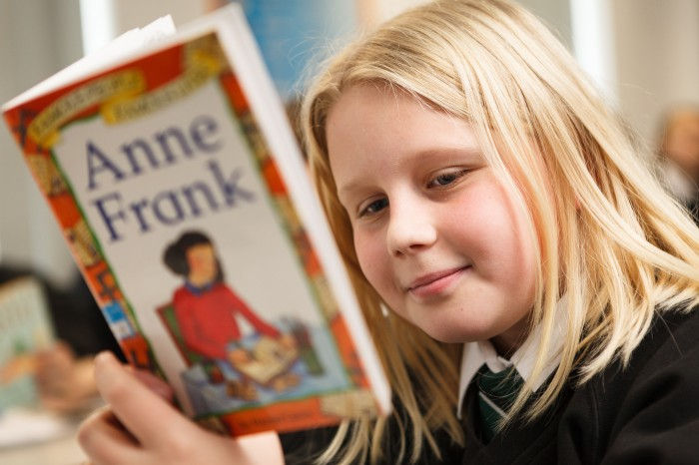
LITERACY

Slide 46
What will be assessed or tested?
Grammar, Punctuation
Spelling
Reading
Writing

Slide 47
What is studied in years 3,4,5,6
Topics the children may cover during this Key Stage include:
Myths and legends
Adventure and mystery stories
Poetry
Stories with historical settings
Stories in imaginary worlds
Stories from other cultures
Significant authors
A variety of non-fiction genres.
Drama
Newspapers and magazine articles
Information texts
Persuasive writing
Biography and autobiography

Slide 48
Reading Years 3,4,5,6
Throughout KS2 the children move from decoding words to interpretation and deduction. At the start of year 3 most children are reading around 300 of the most frequent words: by the end of year 6, most are confident, fluent readers.
Your child will learn to:
Read new words independently
Understand themes, plots and ideas
Recognise the use of figurative language
Identify language structures used to
organise text
Compare different writing styles
Find information in non-fiction and fiction
To infer and deduce. (Work out things using independent thought and life experiences)

Slide 49
Writing Years 3,4,5,6
Writing develops through KS2: handwriting becomes clearer and neater, spelling is more accurate, and punctuation is used correctly. The children write longer pieces now, using characters, dialogue and more imaginative vocabulary.
Just some of the skills your child will learn:
Paragraphs
Punctuation
Sentences with clauses and phrases
Adverbs
Possessive apostrophes
Direct and reported speech
Active and passive voice
Fronted adverbial

Slide 50
What assessments happen at the end of KS2?
Reading - tested under examination conditions
Spelling - tested under examination conditions
Punctuation & Grammar - tested under examination conditions.
Longer Writing will be teacher assessed.

Slide 51
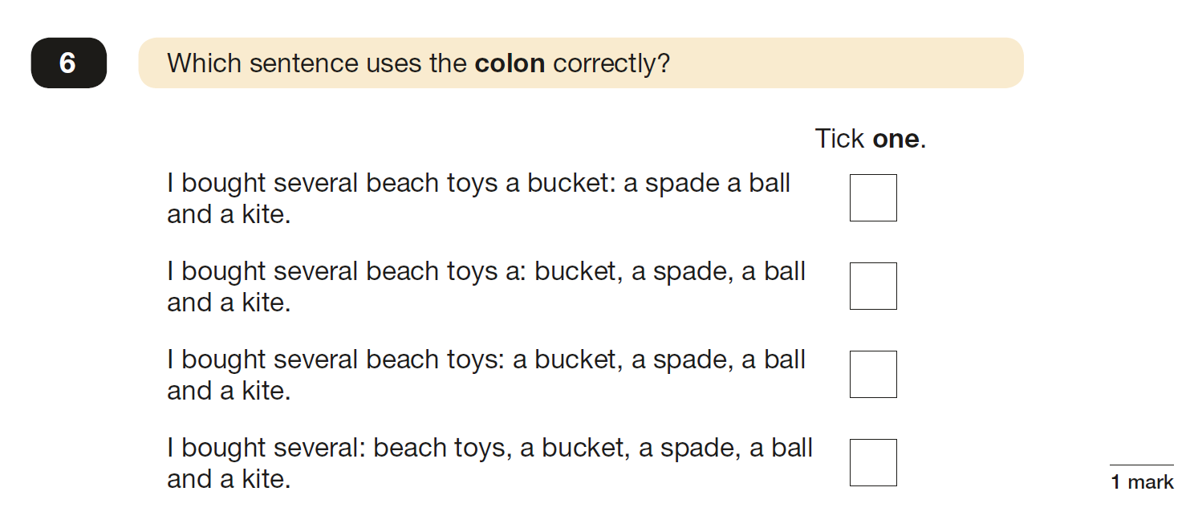
Punctuation and Grammar paper

Slide 52
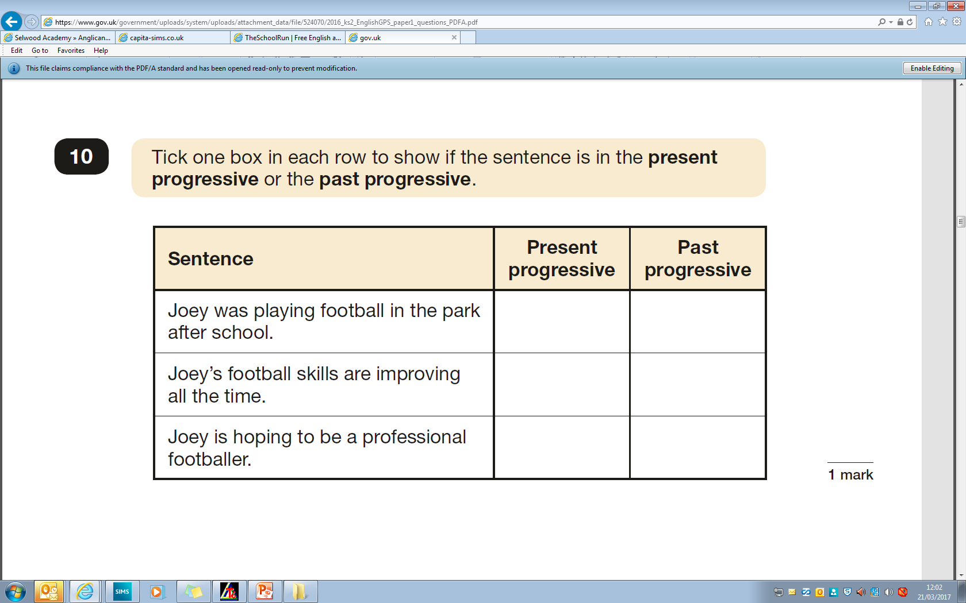
Punctuation and Grammar paper

Slide 53
Punctuation and Grammar paper

Slide 54
Punctuation and Grammar paper

Slide 55
Spelling Paper
Examples of spellings
1. Healthy 6. surprising
2. advantage 7. physical
3. varieties 8. process
4. remember 9. available
5. release 10. medicine
There are 20 spellings in total

Slide 56
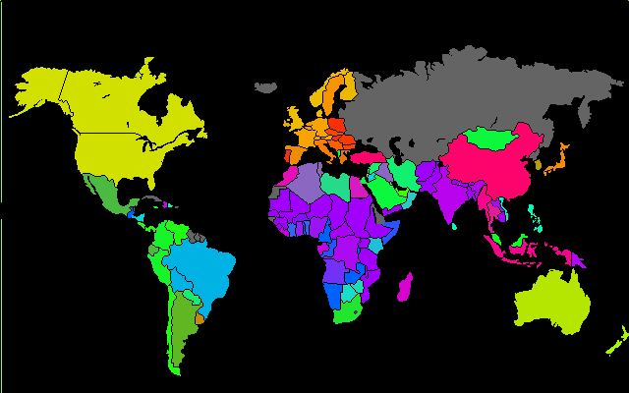
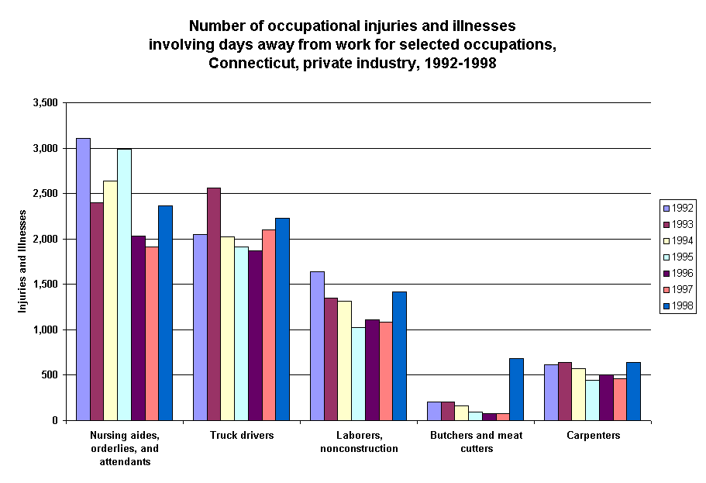
Reading Paper
A booklet of different reading extracts is given to the pupils.
There could be:-
story extracts (fiction)
poetry
non-fiction writing
tables and charts
maps
newspaper extracts

Slide 57
Reading Paper

Slide 58
Reading Paper

Slide 59
What help can we give to pupils?.
We can read the writing papers to the pupils and keep all on task within the time.
We can provide Teaching Assistants to guide and support the process.
We can ensure that pupils do as much of the paper as possible.
www.theschoolrun.com
[Has sample questions and work packs can be bought for approx. £2.00]

Slide 60
Long Writing (Teacher Assessed)
Write a story ...called The Time Machine.
Write a report ... To explain how the Romans beat the Celts.
Write a discussion ... about whether pupils should wear school uniform or not.
Write a biography ...
Write a letter to persuade.

Slide 62
Don’t panic!
Help is at hand.
Visit the school website and look for SATs.

Slide 63
Good sleep patterns
Primary children need between 9 – 11 hours of sleep per night.
Help your child create a relaxing evening routine.
Make sure they don’t eat too late at night.
Avoid caffeine or sugary drinks late at night.
Make sure they don’t work or revise too late before going to bed.
Encourage them to switch off from technology at least an hour before bedtime.

Slide 64
Unplug
Keep active
Time out
Stay calm

Slide 65
High quality teaching and in-class targeted support
Detailed analysis of each pupil’s strengths and areas for development
Integral homework tasks
Additional support (Booster sessions / Targeted holiday homework/revision tasks)
Practice SATs experiences
Breakfast
Sense of proportion

Slide 66
Strive for progress
not perfection
Be proud of your efforts
as well as your achievements
“I can sum up everything I have learned
about life in three words: it goes on”.
(Robert Frost)

